Slide 1
18ECC204J DIGITAL SIGNAL PROCESSING- WEEK 2

Slide 2
Syllabus Overview
Learning Unit / Module 1: Signals and Waveforms
Learning Unit / Module 2: Frequency Transformations
Learning Unit / Module 3: FIR Filters
Learning Unit / Module 4: IIR Filters
Learning Unit / Module 5: Multirate signal Processing

Slide 3
Learning Unit / Module 1: Signals and Waveforms
Basic Elements of DSP , Advantages and applications of DSP
Continuous Time vs Discrete time signals , Continuous valued vs discrete valued signals.
Concepts of frequency in analog signals , Continuous and discrete time sinusoidal signals ,
Sampling of analog signals Sampling theorem
Aliasing Quantization of continuous amplitude signals,
Analog to digital conversion Sample and hold, Quantization and coding
Oversampling A/D converters , Digital to analog conversion Sample and hold
Oversampling D/A converters, Quantization noise
Errors due to truncation,Probability of error
Errors due to rounding

Slide 4
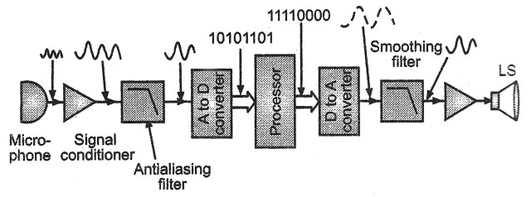
Block Diagram of DSP

Slide 5
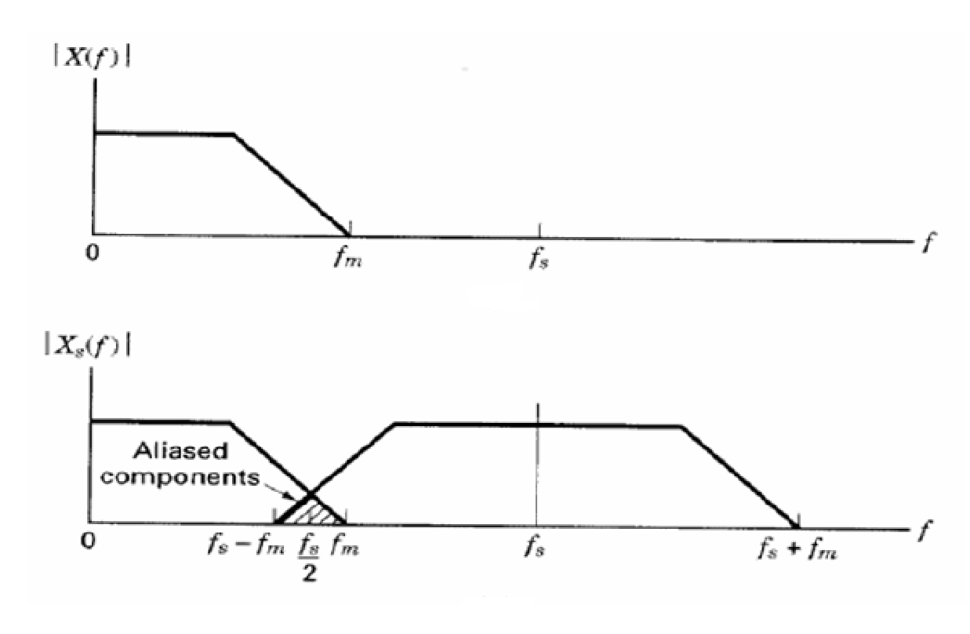
Illustration of Aliasing Effects

Slide 6
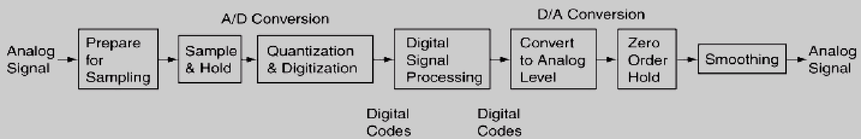
A/D & D/A Conversion

Slide 7
Analog to Digital (A/D) Conversion
Most signals of practical interest are analog in nature
Examples: Voice, Video, RADAR signals, Transducer/Sensor output, Biological signals etc
So in order to utilize those benefits, we need to convert our analog signals into digital
This process is called A/D conversion

Slide 8
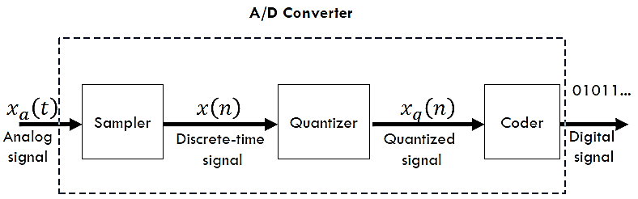
Analog to Digital Conversion
A/D conversion can be viewed as a three step process

Slide 9
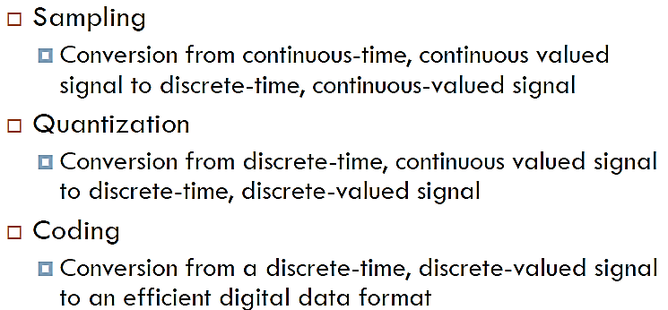
Analog to Digital Conversion
A/D conversion can be viewed as a three step process

Slide 10
Analog to Digital Conversion
Sample & Hold (Sampler)
Analog signal is continuous in time and continuous in amplitude.
It means that it carries infinite information of time and infinite information of amplitude.
Analog (continuous-time) signal has some value defined at every time instant, so it has infinite number of sample points.

Slide 11
Analog to Digital Conversion
Sample & Hold (Sampler)
It is impossible to digitize an infinite number of points.
The infinite points cannot be processed by the digital signal (DS) processor or computer, since they require an infinite amount of memory and infinite amount of processing power for computations.
Sampling is the process to reduce the time information or sample points.

Slide 12
Analog to Digital Conversion
Sample & Hold (Sampler)
The first essential step in analog-to-digital (A/D) conversion is to sample an analog signal.
This step is performed by a sample and hold circuit, which samples at regular intervals called sampling intervals.
Sampling can take samples at a fixed time interval.
The length of the sampling interval is the same as the sampling period, and the reciprocal of the sampling period is the sampling frequency fs.

Slide 13
Analog to Digital Conversion
Sample & Hold (Sampler)
After a brief acquisition time, during which a sample is acquired, the sample and hold circuit holds the sample steady for the remainder of the sampling interval.
The hold time is needed to allow time for an A/D converter to generate a digital code that best corresponds to the analog sample.
If x(t) is the input to the sampler, the output is x(nT), where T is called the sampling interval or sampling period.
After the sampling, the signal is called “discrete time continuous signal” which is discrete in time and continuous in amplitude.

Slide 14
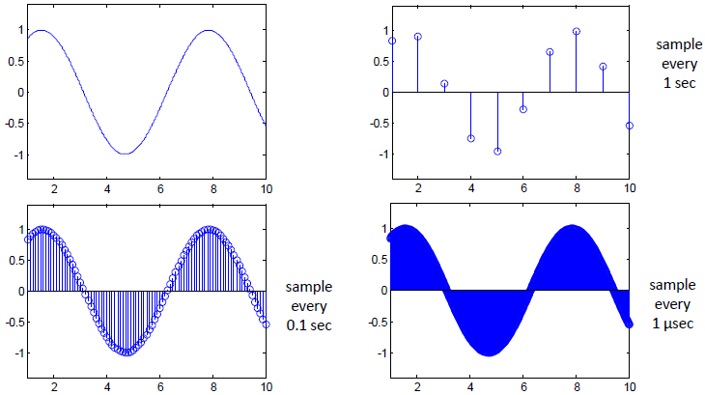
Analog to Digital Conversion
Sample & Hold (Sampler)

Slide 15
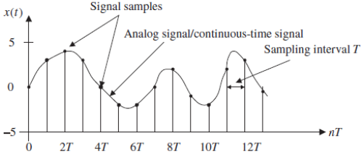
Analog to Digital Conversion
Sample & Hold (Sampler)
Figure below shows an analog (continuous-time) signal (solid line) defined at every point over the time axis (horizontal line) and amplitude axis (vertical line).
Hence, the analog signal contains an infinite number of points.

Slide 16
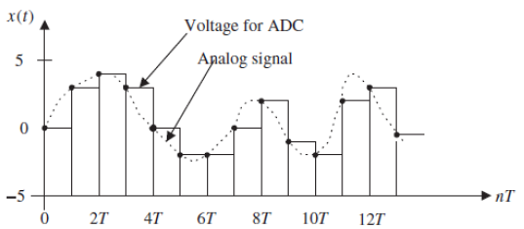
Analog to Digital Conversion
Sample & Hold (Sampler)
Each sample maintains its voltage level during the sampling interval 𝑻 to give the ADC enough time to convert it.
This process is called sample and hold.

Slide 17
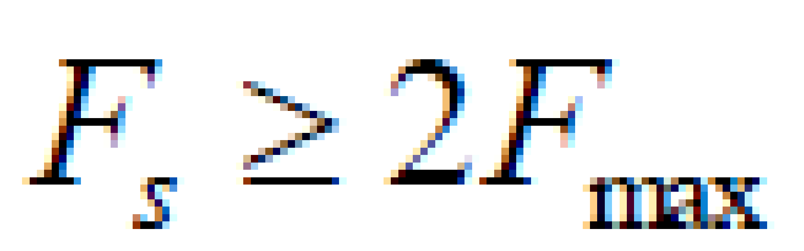
Nyquist–Shannon Sampling Theorem
The sampling theorem guarantees that an analogue signal can be perfectly recovered as long as the sampling rate is at least twice as large as the highest-frequency component of the analogue signal to be sampled.

Slide 18
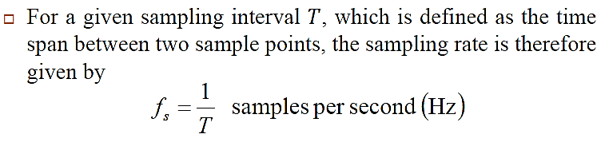
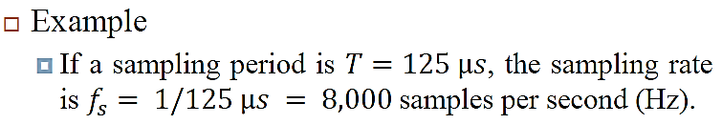
Nyquist–Shannon Sampling Theorem

Slide 19
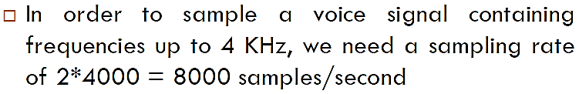
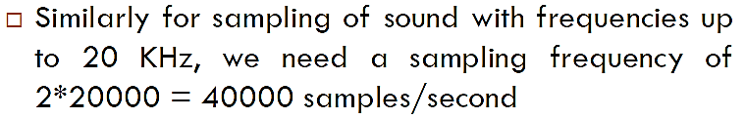
Nyquist–Shannon Sampling Theorem
Examples

Slide 20

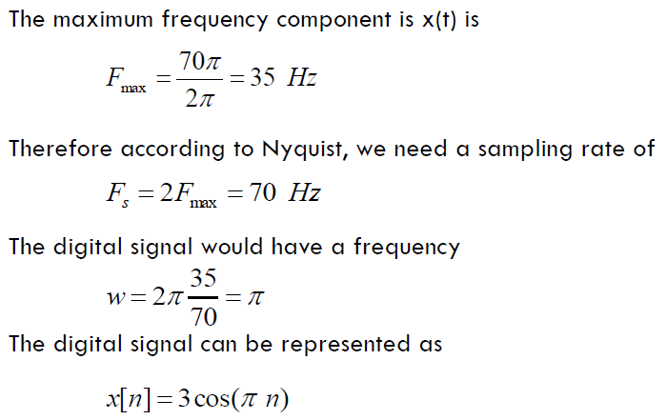
Nyquist–Shannon Sampling Theorem
Example: For the following analog signal, find the Nyquist sampling rate, also determine the digital signal frequency and the digital signal

Slide 21
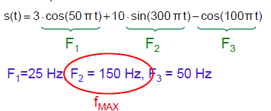

Nyquist–Shannon Sampling Theorem
Example: Find the sampling frequency of the following signal.
So sampling frequency should be

Slide 22
Nyquist–Shannon Sampling Theorem
Exercise
Determine the Nyquist sampling rate of a signal
x(t) = 3sin(5000πt + 17º)

Slide 23
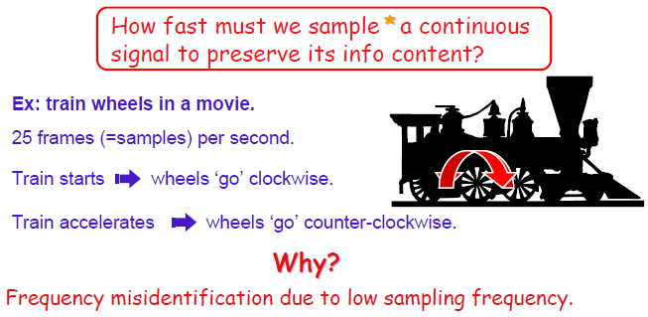
Aliasing

Slide 24
Aliasing
How many hertz can the human eye see?
Most don't notice unless it is under 50 or 60 Hz.
Generally, people notice when the frame-rate is less than the refresh rate of the display.
Depending on the type of CRT, you couldn't see flicker at 30 Hz or you could still see it at 120 Hz.

Slide 25
Aliasing
When the minimum sampling rate is not respected, distortion called aliasing occurs.
Aliasing causes high frequency signals to appear as lower frequency signals.
To be sure aliasing will not occur, sampling is always preceded by low pass filtering.
The low pass filter, called the anti-aliasing filter, removes all frequencies above half the selected sampling rate.

Slide 26
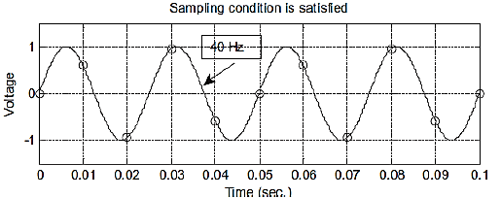
Aliasing
Figure illustrates sampling a 40 Hz sinusoid
The sampling interval between sample points is T = 0.01 second, and the sampling rate is thus fs = 100 Hz.
The sampling theorem condition is satisfied

Slide 27
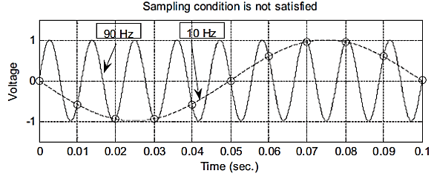
Aliasing
Figure illustrates sampling a 90 Hz sinusoid
The sampling interval between sample points is T = 0.01 second, and the sampling rate is thus fs = 100 Hz.
The sampling theorem condition is not satisfied

Slide 28
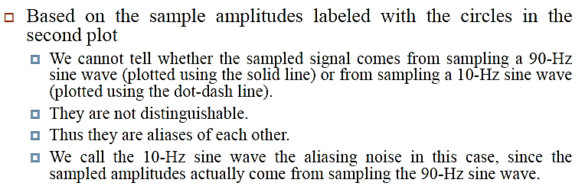
Aliasing

Slide 29
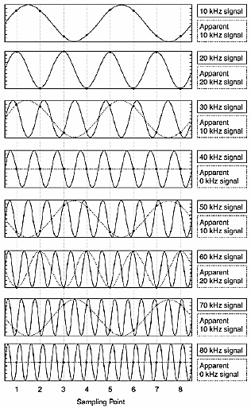
Sampling Effect in Time Domain
Example of Aliasing in the time domain of various sinusoidal signals ranging from 10 kHz to 80 kHz with a sampling frequency Fs = 40 kHz.

Slide 30
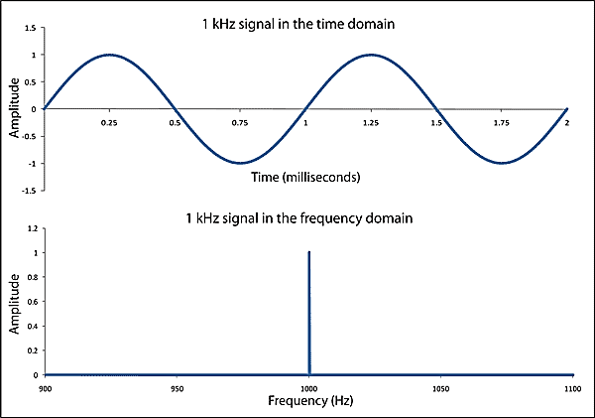
Time & Frequency Domains
There are two complementary signal descriptions.
Signals seen as projected onto time or frequency domains.

Slide 31
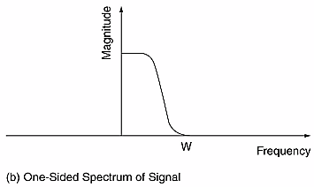
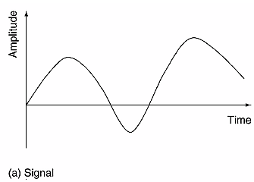
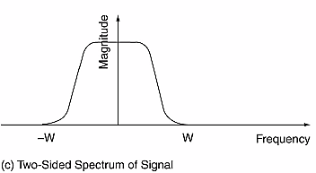
Signal & Spectrum

Slide 32
Frequency Range of Analog & Digital Signals
For analog signals, the frequency range is from -∞ Hz to ∞ Hz
For digital signals, the frequency range is from 0 Hz to Fs/2 Hz

Slide 33
Sampling Effect in Frequency Domain
Sampling causes images of a signal’s spectrum to appear at every multiple of the sampling frequency fs.
For a signal with frequency f, the sampled spectrum has frequency components at kfs ± f

Slide 34
Anti Aliasing Filter
A signal with no frequency component above a certain maximum frequency is known as a band-limited signal.
In our case we want to have a signal band-limited to ½ Fs.
Some times higher frequency components (both harmonics and noise) are added to the analog signal (practical signals are not band-limited).
In order to keep analog signal band-limited, we need a filter, usually a low pass that stops all frequencies above ½ Fs.
This is called an “Anti-Aliasing” filter.

Slide 35
Anti Aliasing Filter
Anti-aliasing filters are analog filters.
They process the signal before it is sampled.
In most cases, they are also low-pass filters unless band-pass sampling techniques are used.

Slide 36
Under Sampling
If the sampling rate is lower than the required Nyquist rate, that is f_{S} < 2W, it is called under sampling.
In under sampling images of high frequency signals erroneously appear in the baseband (or Nyquist range) due to aliasing.

Slide 37
Sampling of Band Limited Signals
Signals whose frequencies are restricted to a narrow band of high frequencies can be sampled at a rate similar to twice the Bandwidth (BW) instead of twice the maximum frequency.
Fs ≥ BW

Slide 38
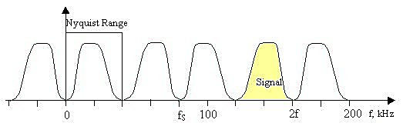
Sampling of Band Limited Signals
While this under-sampling is normally avoided, it can be exploited.
For example, in the case of band limited signals all of the important signal characteristics can be deduced from the copy of the spectrum that appears in the baseband through sampling.
Depending on the relationship between the signal frequencies and the sampling rate, spectral inversion may cause the shape of the spectrum in the baseband to be inverted from the true spectrum of the signal.

Slide 39
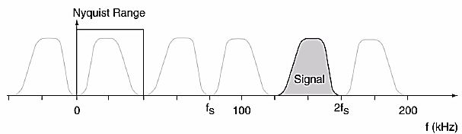
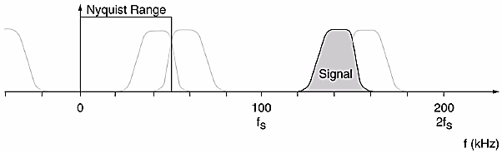
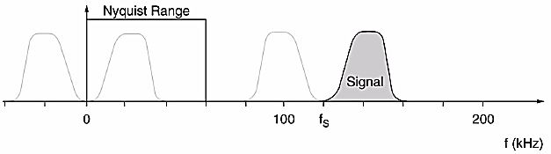
Sampling of Band Limited Signals
Figure: Signal recovered
From Nyquist range are
Base band versions of the
Original signal. Sampling rate is
Important to make sure no aliasing
and spectral inversion occurs.
Fs = 80 kHz, signal spectrum
is Inverted in the baseband.
(b) Fs = 100 kHz, the lowest
Frequencies In the signal alias
to the highest frequencies.
(c) Fs = 120 kHz, No spectral
Inversion occurs.

Slide 40
Over Sampling
Oversampling is defined as sampling above the minimum Nyquist rate, that is, f_{S} > 2f_{max}.
Oversampling is useful because it creates space in the spectrum that can reduce the demands on the analog anti-aliasing filter.

Slide 41
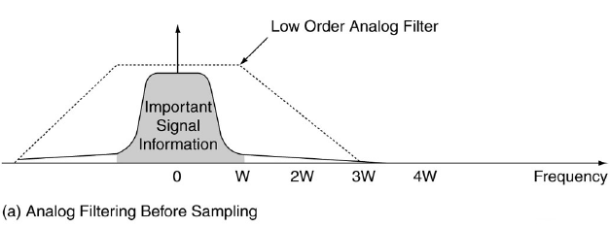
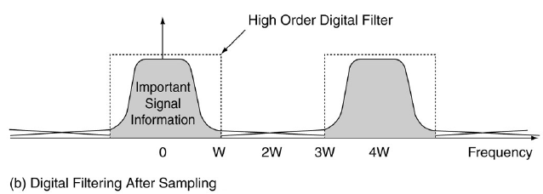
Over Sampling
In the example below, 2x oversampling means that a low order analog filter is adequate to keep important signal information intact after sampling.
After sampling, higher order digital filter can be used to extract the information.

Slide 42
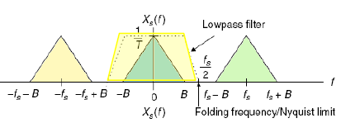
Over Sampling
The ideal filter has a flat pass-band and the cut-off is very sharp, since the cut-off frequency of this filter is half of that of the sampling frequency, the resulting replicated spectrum of the sampled signal do not overlap each other. Thus no aliasing occurs.
Practical low-pass filters cannot achieve the ideal characteristics.
Firstly, this would mean that we have to sample the filtered signals at a rate that is higher than the Nyquist rate to compensate for the transition band of the filter

Slide 43
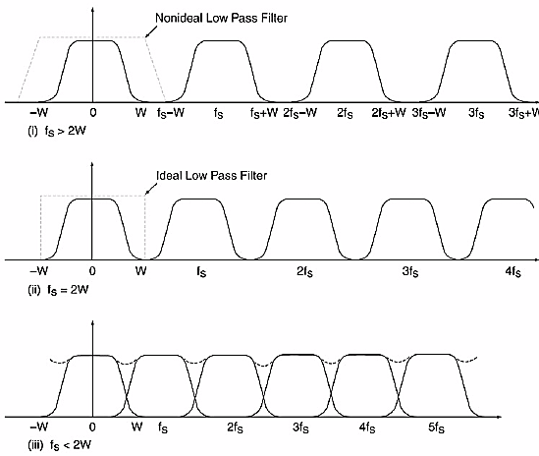
Spectra of Sampled signals
Figure: Signal ‘s Spectra
Over sampled
Nyquest Rate
Under Sampled

Slide 44
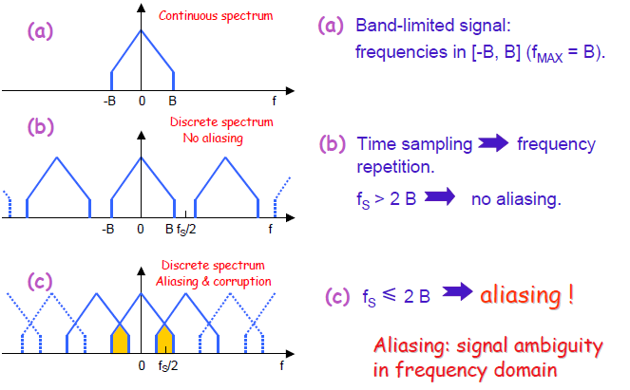
Sampling Low Pass Signals

Slide 45
Exercise
Exercise-1: If the 20 kHz signal is under-sampled at 30 kHz, find the aliased frequency of the signal.
Exercise-2: A voice signal is sampled at 8000 samples per second.
What is the time between samples?
What is the maximum frequency that will be recovered from the signal?
Exercise-3: An analog Electromyogram (EMG) signal contains useful frequencies up to 3000 Hz.
Determine the minimum required sampling rate to avoid aliasing.
Suppose that we sample this signal at a rate of 6500 samples/s. what is the highest frequency that can be represented uniquely at this sampling rate?

Slide 46
Analog to Digital Conversion
Quantizer
After the sampling, the discrete time continuous signal still carry infinite information (can take any value) in terms of amplitude.
Quantization is the process to reduce infinite information of the amplitude.
Quantizer do the conversion of discrete time continuous valued signal into a discrete-time discrete-value signal.
The value of each signal sample is represented by a value selected from a finite set of possible values.

Slide 47
Analog to Digital Conversion
Quantizer
The A/D converter chooses a quantization level for each analog sample.
Number of levels of quantizer is equal to L = 2^{N}
An N-bit converter chooses among 2^{N} possible quantization levels.
So 3 bit converter has 8 quantization levels, and 4 bit converter has 8 quantization levels.

Slide 48
Analog to Digital Conversion
The quantization step size or resolution is calculated as:
Δ = Q = R/2^{N}
where
R is the full scale range of the analog signal (i.e. Y_{max} - Y_{min})
N is the number of bits used by the converter
Resolution of a quantizer is the distance between two successive quantization levels
More quantization levels, a better resolution!
What's the downside of more quantization levels?
The strength of the signal compared to that of the quantization errors is measured by dynamic range and signal-to-noise ratio.

Slide 49
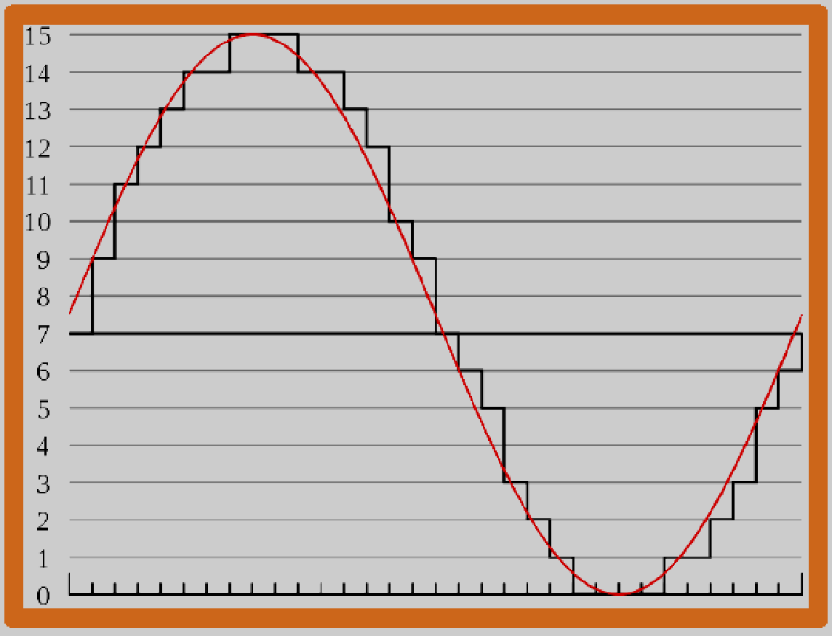
Analog to Digital Conversion
4-bit Quantizer

Slide 50
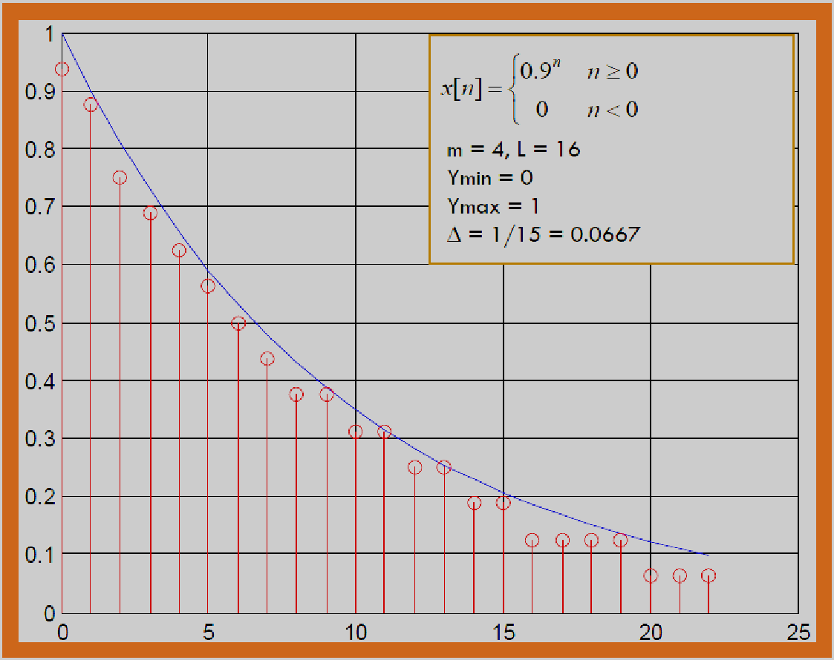
Analog to Digital Conversion
4-bit Quantizer

Slide 51
Quantization Error
The error caused by representing a continuous-valued signal (infinite set) by a finite set of discrete-valued levels.
The larger the number of quantization levels, the smaller the quantization errors.
The quantization error is calculated as the difference between the quantized level and the true sample level.
Most quantization errors are limited in size to half a quantization step Q or Δ .

Slide 52
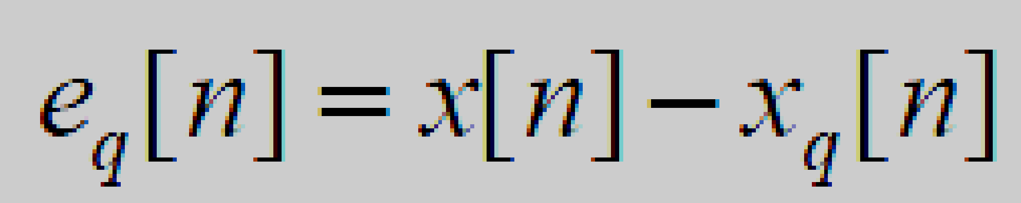
Quantization Error
Suppose a quantizer operation given by Q(.) is performed on continuous-valued samples x[n] is given by Q(x[n]), then the quantization error is given by

Slide 53
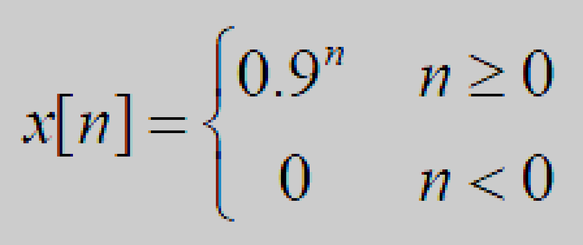
Analog to Digital Conversion
Lets consider the signal which is to be quantized.
In the figure, we can see that there is a difference between the original signal (Blue Line) and the quantized signal (Red Lines). This is the error produced while quantization

Slide 54
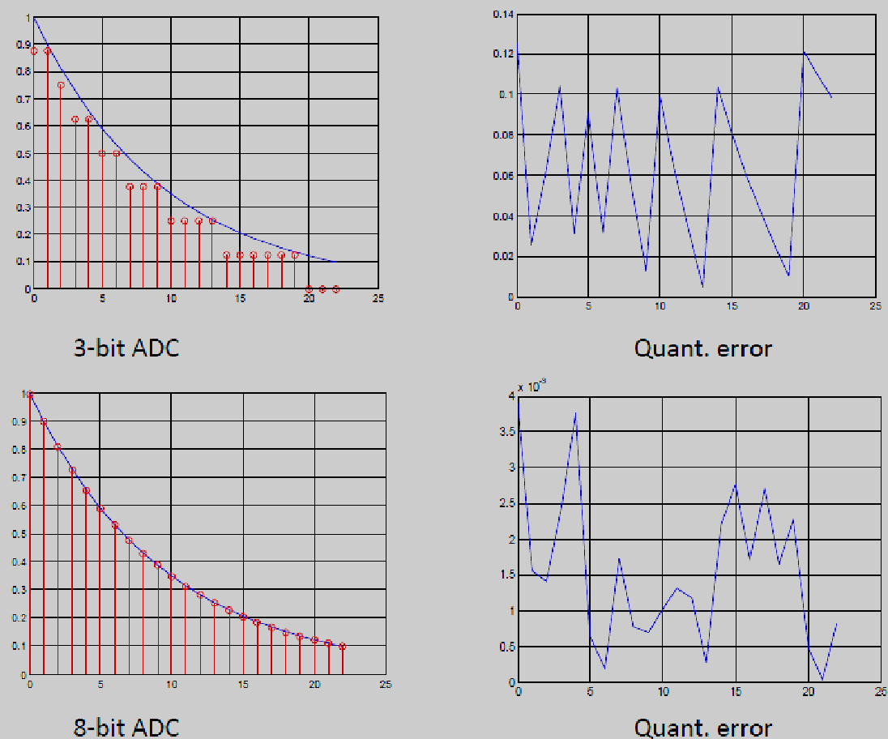
Analog to Digital Conversion
Quantization error can be reduced, however, if the number of quantization levels is increased as illustrated in the figure

Slide 55
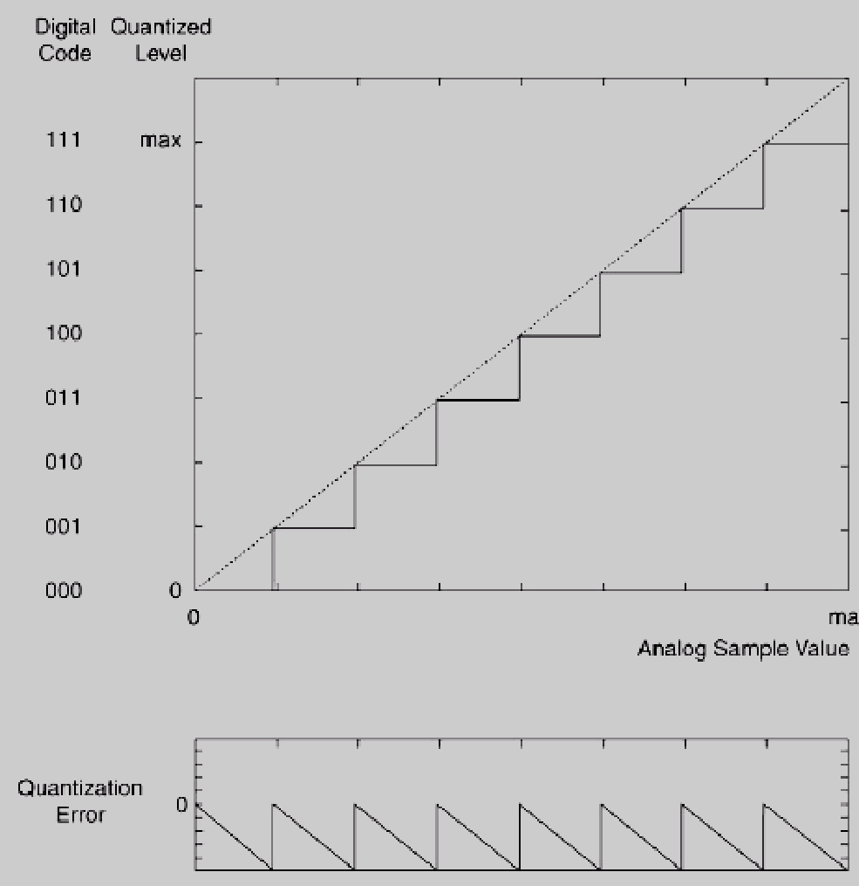
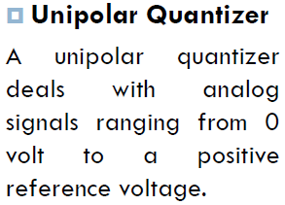
Analog to Digital Conversion
Quantization of unipolar data (maximum error = full step)

Slide 56
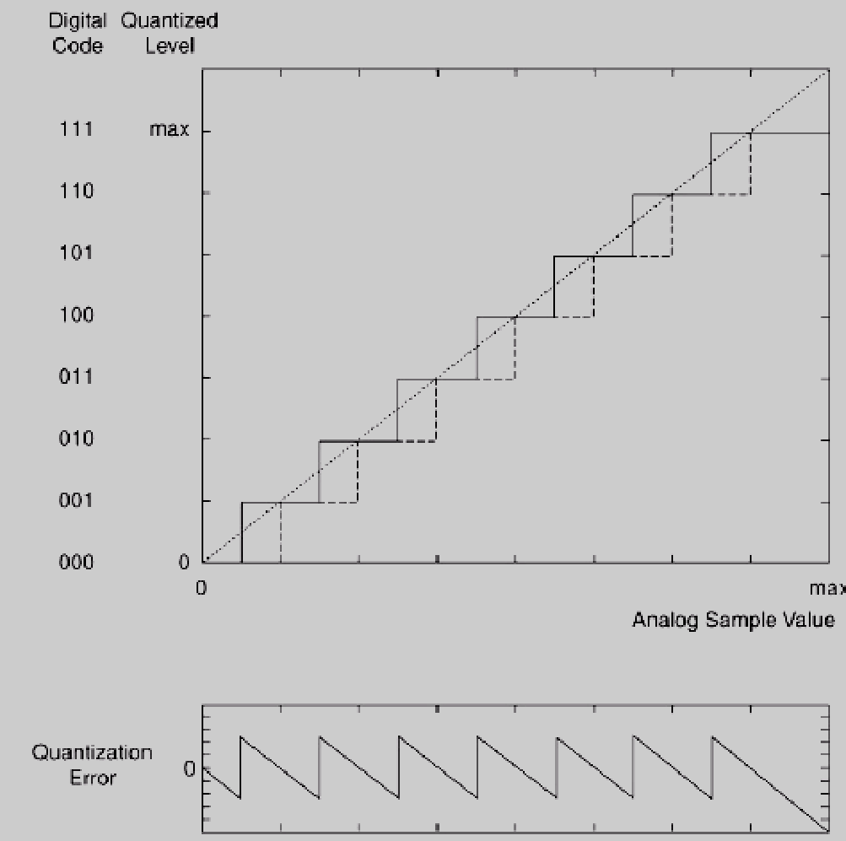
Analog to Digital Conversion
Quantization of unipolar data (maximum error = half step)

Slide 57
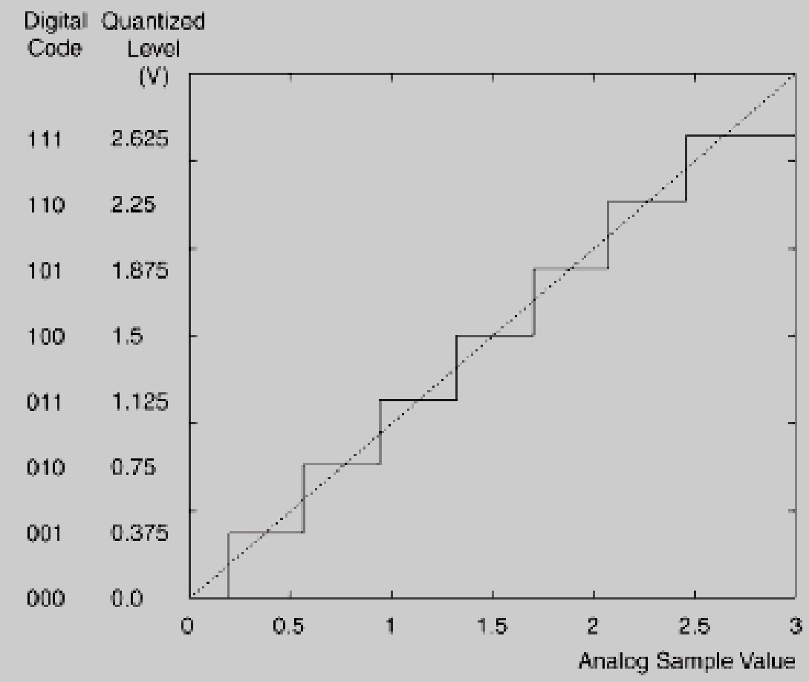
Analog to Digital Conversion
Example: Analog pressures are recorded using a pressure transducer as voltages between 0 and 3 V. The signal must be quantized using a 3-bit digital code. Indicate how the analog voltages will be covered to digital values.
The quantization step size is
Q = 3 V/2³ = 0.375 V
The half of quantization step is
0.1875 V

Slide 58
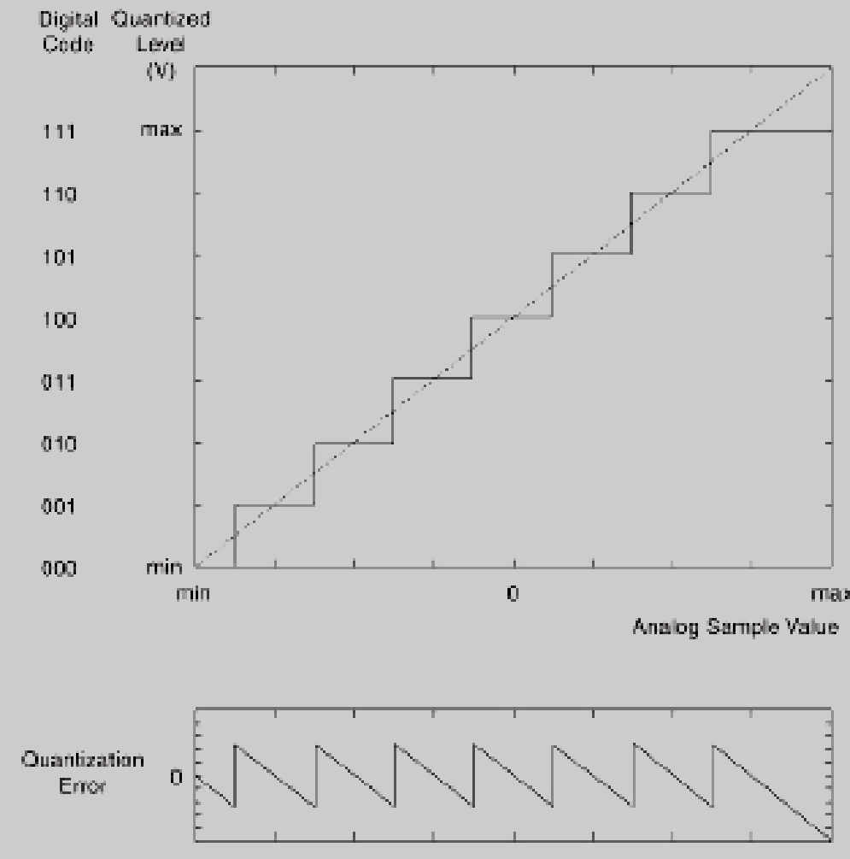
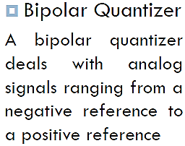
Analog to Digital Conversion
Quantization of bipolar data (maximum error = half step)

Slide 59
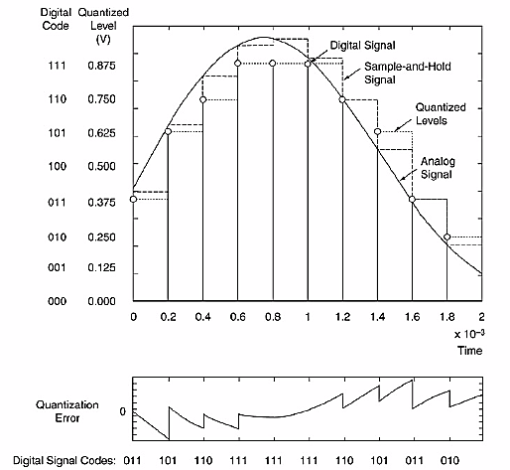
Three-bit A/D Conversion

Slide 60
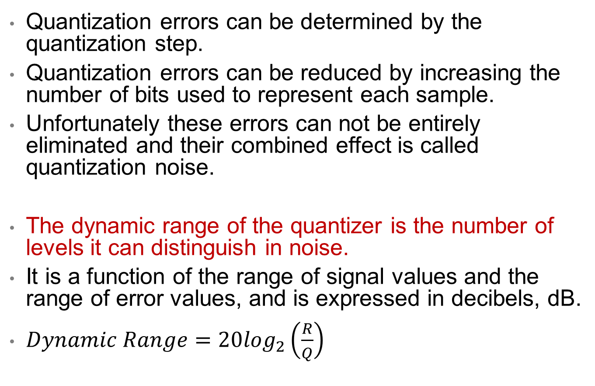
Dynamic Range

Slide 61
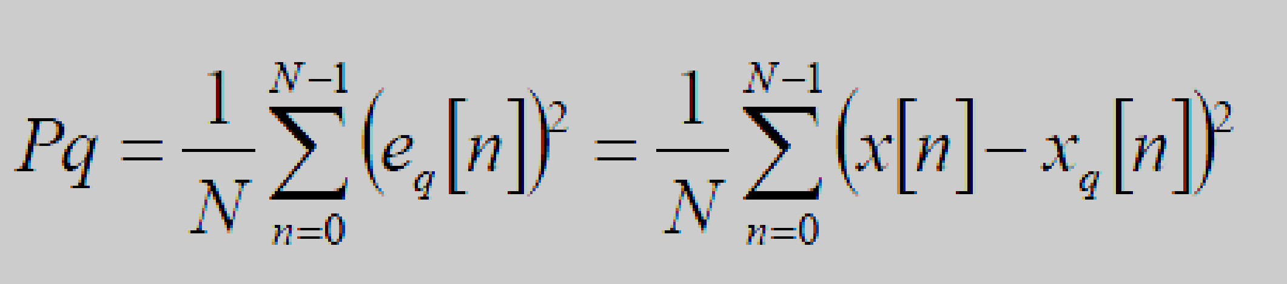
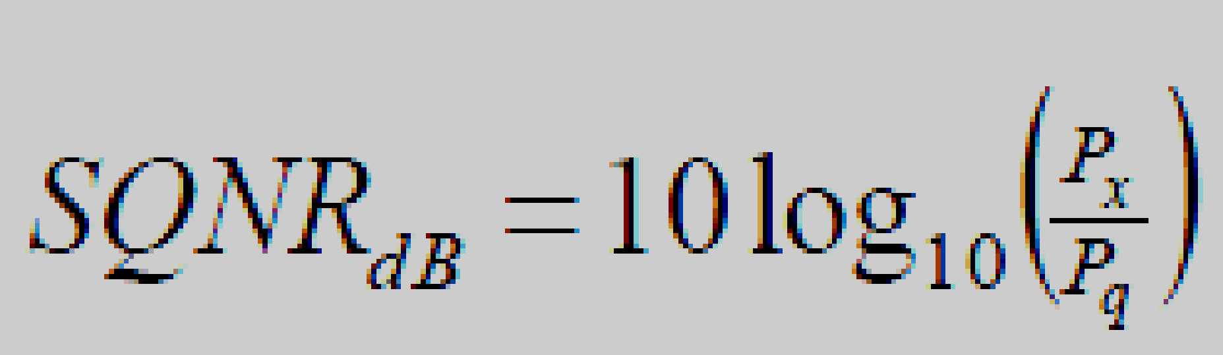
Signal-to-Quantization-Noise Ratio
Provides the ratio of the signal power to the quantization noise (or quantization error)
Mathematically,
where
P_{x}= Power of the signal ‘x’ (before quantization)
P_{q}= Power of the error signal ‘x_{q}’

Slide 62
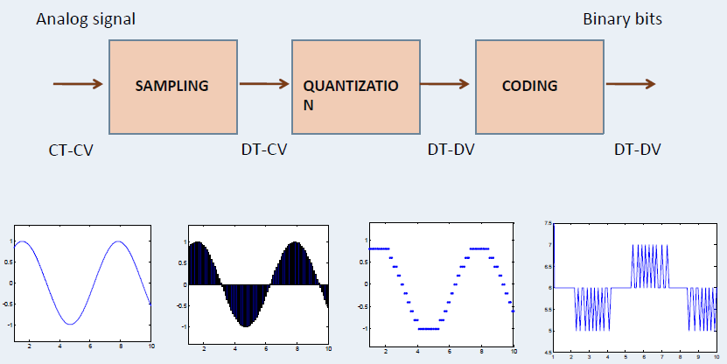
Analog to Digital Conversion

Slide 63
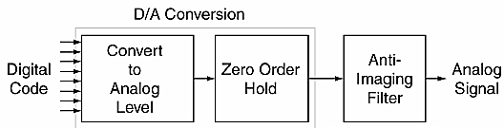

Digital-to-Analog (D/A) Conversion
Block Diagram of D/A Conversion

Slide 64
Digital-to-Analog (D/A) Conversion
Once digital signal processing is complete, digital-to-analog (D/A) conversion must occur.
This process begins by converting each digital code into an analog voltage that is proportional in size to the number represented by the code.
This voltage is held steady through zero order hold until the next code is available, one sampling interval later.
This creates a staircase-like signal that contains frequencies above W Hz.
These signals are removed with a smoothing analog low pass filter, the last step in D/A conversion.

Slide 65
Digital-to-Analog (D/A) Conversion
In the frequency domain, the high frequency elements present in the zero order hold signal appear as images, copies of the original signal spectrum situated around integer multiples of the sampling frequency.
The smoothing analog filter removes these images and so is given the name of Anti-Imaging Filter.
Only the frequencies in the baseband, between 0 and f_{S}/2 Hz, remain.

Slide 66

Digital-to-Analog (D/A) Conversion
Three bit D/A Conversion

Slide 67


Comparing Signals in the A/D & D/A Chain

Slide 68


Comparing Signals in the A/D & D/A Chain

Slide 69

Summary

Slide 70

Summary

Slide 71
Review Questions
What is Aliasing
Compare undersampling and oversampling

Slide 72
ANSWERS Sampling Low Pass Signals

Slide 73
References:
https://wiki.seg.org/wiki/Frequency_aliasing
https://sciencing.com/calculate-alias-frequency-8619254.html#:~:text=Aliasing%20is%20an%20undesired%20effect,of%20a%20much%20higher%20frequency.
National Instruments; Bandwidth, Sample Rate, and Nyquist Theorem; Sep 6, 2006
Sound on Sound: Q. What is 'Aliasing' and What's the Cause of It?

